Slide 1
Cranleigh RFC Annual AGM 2021
Wednesday 9th June 2021

Slide 2
Agenda 2021
Chairman opens and welcomes -Toby Eves
House rules - Toby Eves
Apologies for absence -Toby Eves
President address - Gareth Stingemore
Minutes from Last AGM - Toby Eves
Election of officers - Toby Eves
Financials and Incorporation - Mike Chapman
Any Questions Break
Overview from committee members - M&Y Report - Paul Denyer - Communications and online - Nick Hendy - Grounds - Simon Killick - Director of Rugby Report - Nic Churchill
Any Questions
Any Other Business
Chairman Closes

Slide 3
Chairman Report – Toby Eves
I am going to try to keep this as brief as possible, as our President Gareth Stingemore will provide an excellent summary of the 2020/21 “season” such as it was & the progress that our Committee has made over the past year. Nic Churchill will also cover the playing side in some detail too.
I would like to start by thanking all those members who have stepped forward to serve our Club, whether either on the Committee or in any other voluntary capacity. As ever, some are now standing down, some continuing to serve & others will step up to the plate. All give or have given what they can when they can, for which the Club is most grateful.
I do not want to single out individuals but must make special mention though of one particular lady, well known to us all, namely Mrs H. Anna has provided our match teas for far longer than most of us can remember but has now had to retire from that role. She has already been honoured by being made a Lifetime VP, but we will be looking for a suitable “retirement gift” to say thank you.
Gareth has as I say covered many aspects of our progress as a Club during 2020/21, as well as some exciting future plans that your Committee are currently working on. As he says, a lot of the hard work does go on behind the scenes, often unseen & unheard. Those contributors know who they are & they have my sincere thanks for the unstinting support that they have provided me with in my first year as Chairman of Cranleigh RFC.
Mike Chapman in his Treasurer’s Report will cover our financial position which I am pleased to say is as strong as it has ever been. A significant part of this is due to the continued financial support of our membership, our VPs & sponsors. Full advantage of various financial assistance packages has been taken where available & deemed prudent.

Slide 4
Chairman Report – Toby Eves
We have supported our local community & launched several mental health related & other initiatives, details of which are covered by others. Such things are vitally important; they define who we are & what we stand for as a Club within our community.
Our Honourable Secretary Amanda Newman-Parsons has made tremendous progress in many areas & her partner Simon Killick likewise on the drainage & grounds in general, more details will follow but we owe them both a major vote of thanks.
Paul Denyer & his Mini & Youth section have also worked tirelessly to provide opportunities for our youngsters. Coaches & managers have not only provided rugby where possible but many other team related activities. Once again, more detail is provided by Paul in his report.
Paul Mahon has had the unenviable task of trying to keep our bar open in a Covid compliant fashion, clearly not to the entire satisfaction of Waverley’s environmental health inspectors, but he is working very hard with our Club Custodian Martin Smith to address these issues to their satisfaction. We have been very carefully, but clearly not enough for some!
Looking forward, after an extremely challenging year during which we have managed to achieve our main aim of consolidation, there are many exciting opportunities that lie ahead of us as a Club.
If you feel able to contribute in anyway, however great or small, there are several vacancies that need filling so please do step forward to assist your Club.
Thanks again for your continued support.
Toby Eves, Chairman of Cranleigh RFC

Slide 5
House Rules
All Microphones to be on mute at all times unless you are speaking
A voting poll with show up on your screen, please vote when required
To propose or second please write in the chat with your name and propose or second

Slide 6
Apologies for Absence
John Discombe
Anthony Jones
Dan Cast
Rob Woodley
Fielden Family
Kev Downes
Dan Spong
Jake Clacton

Slide 7
President Address - Gareth Stingemore
Player retention
Promotion
Grounds
4G Pitch
Third party users
Extension

Slide 8
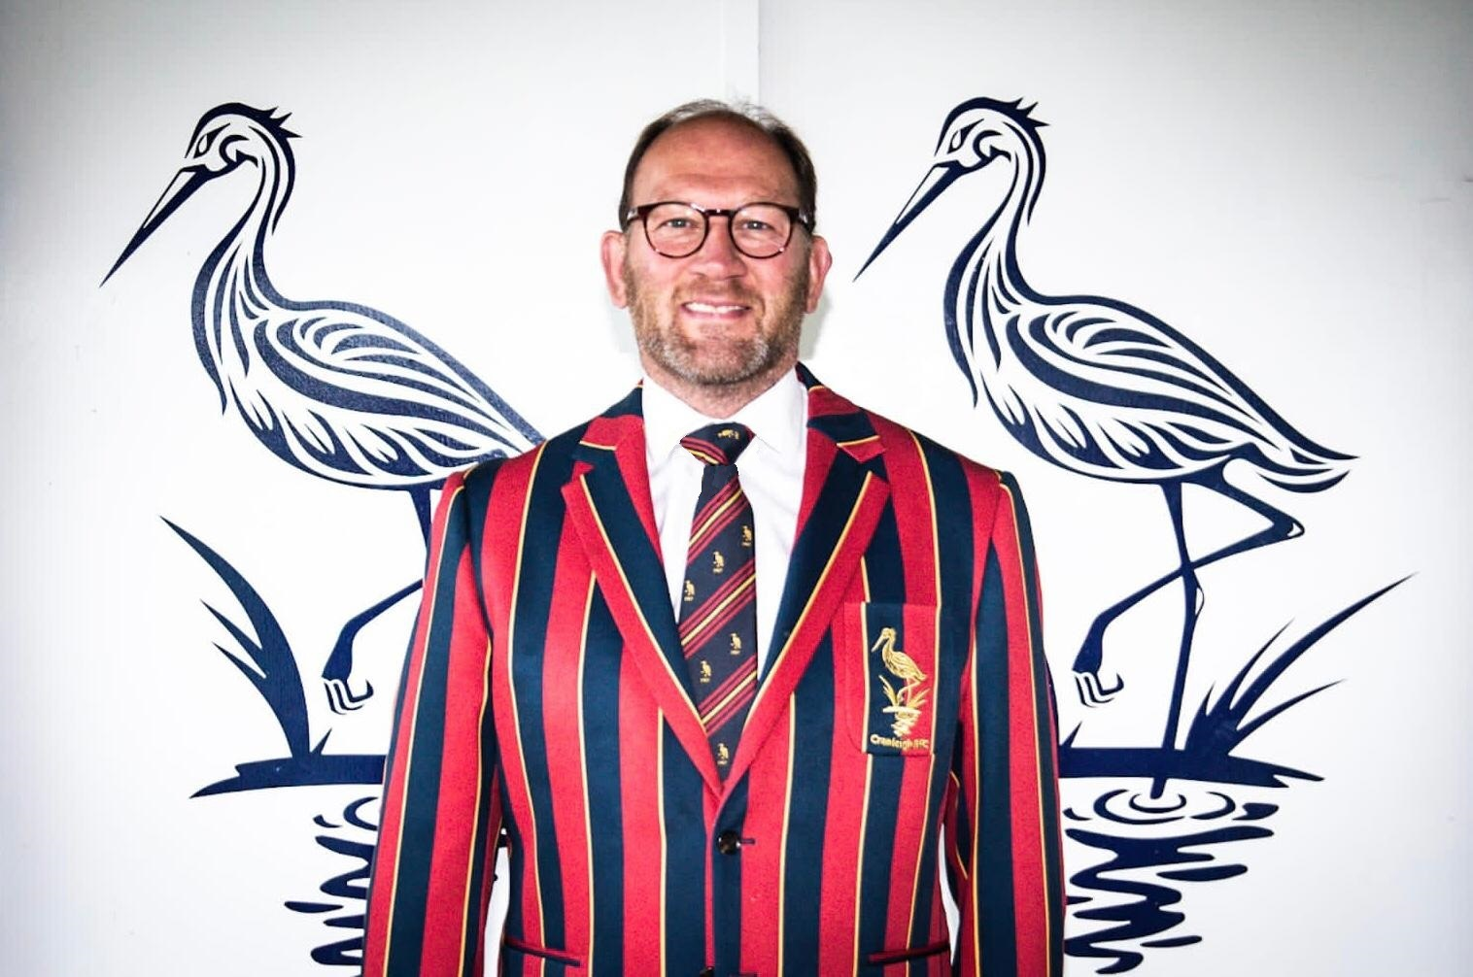
President Address - Gareth Stingemore

Slide 9
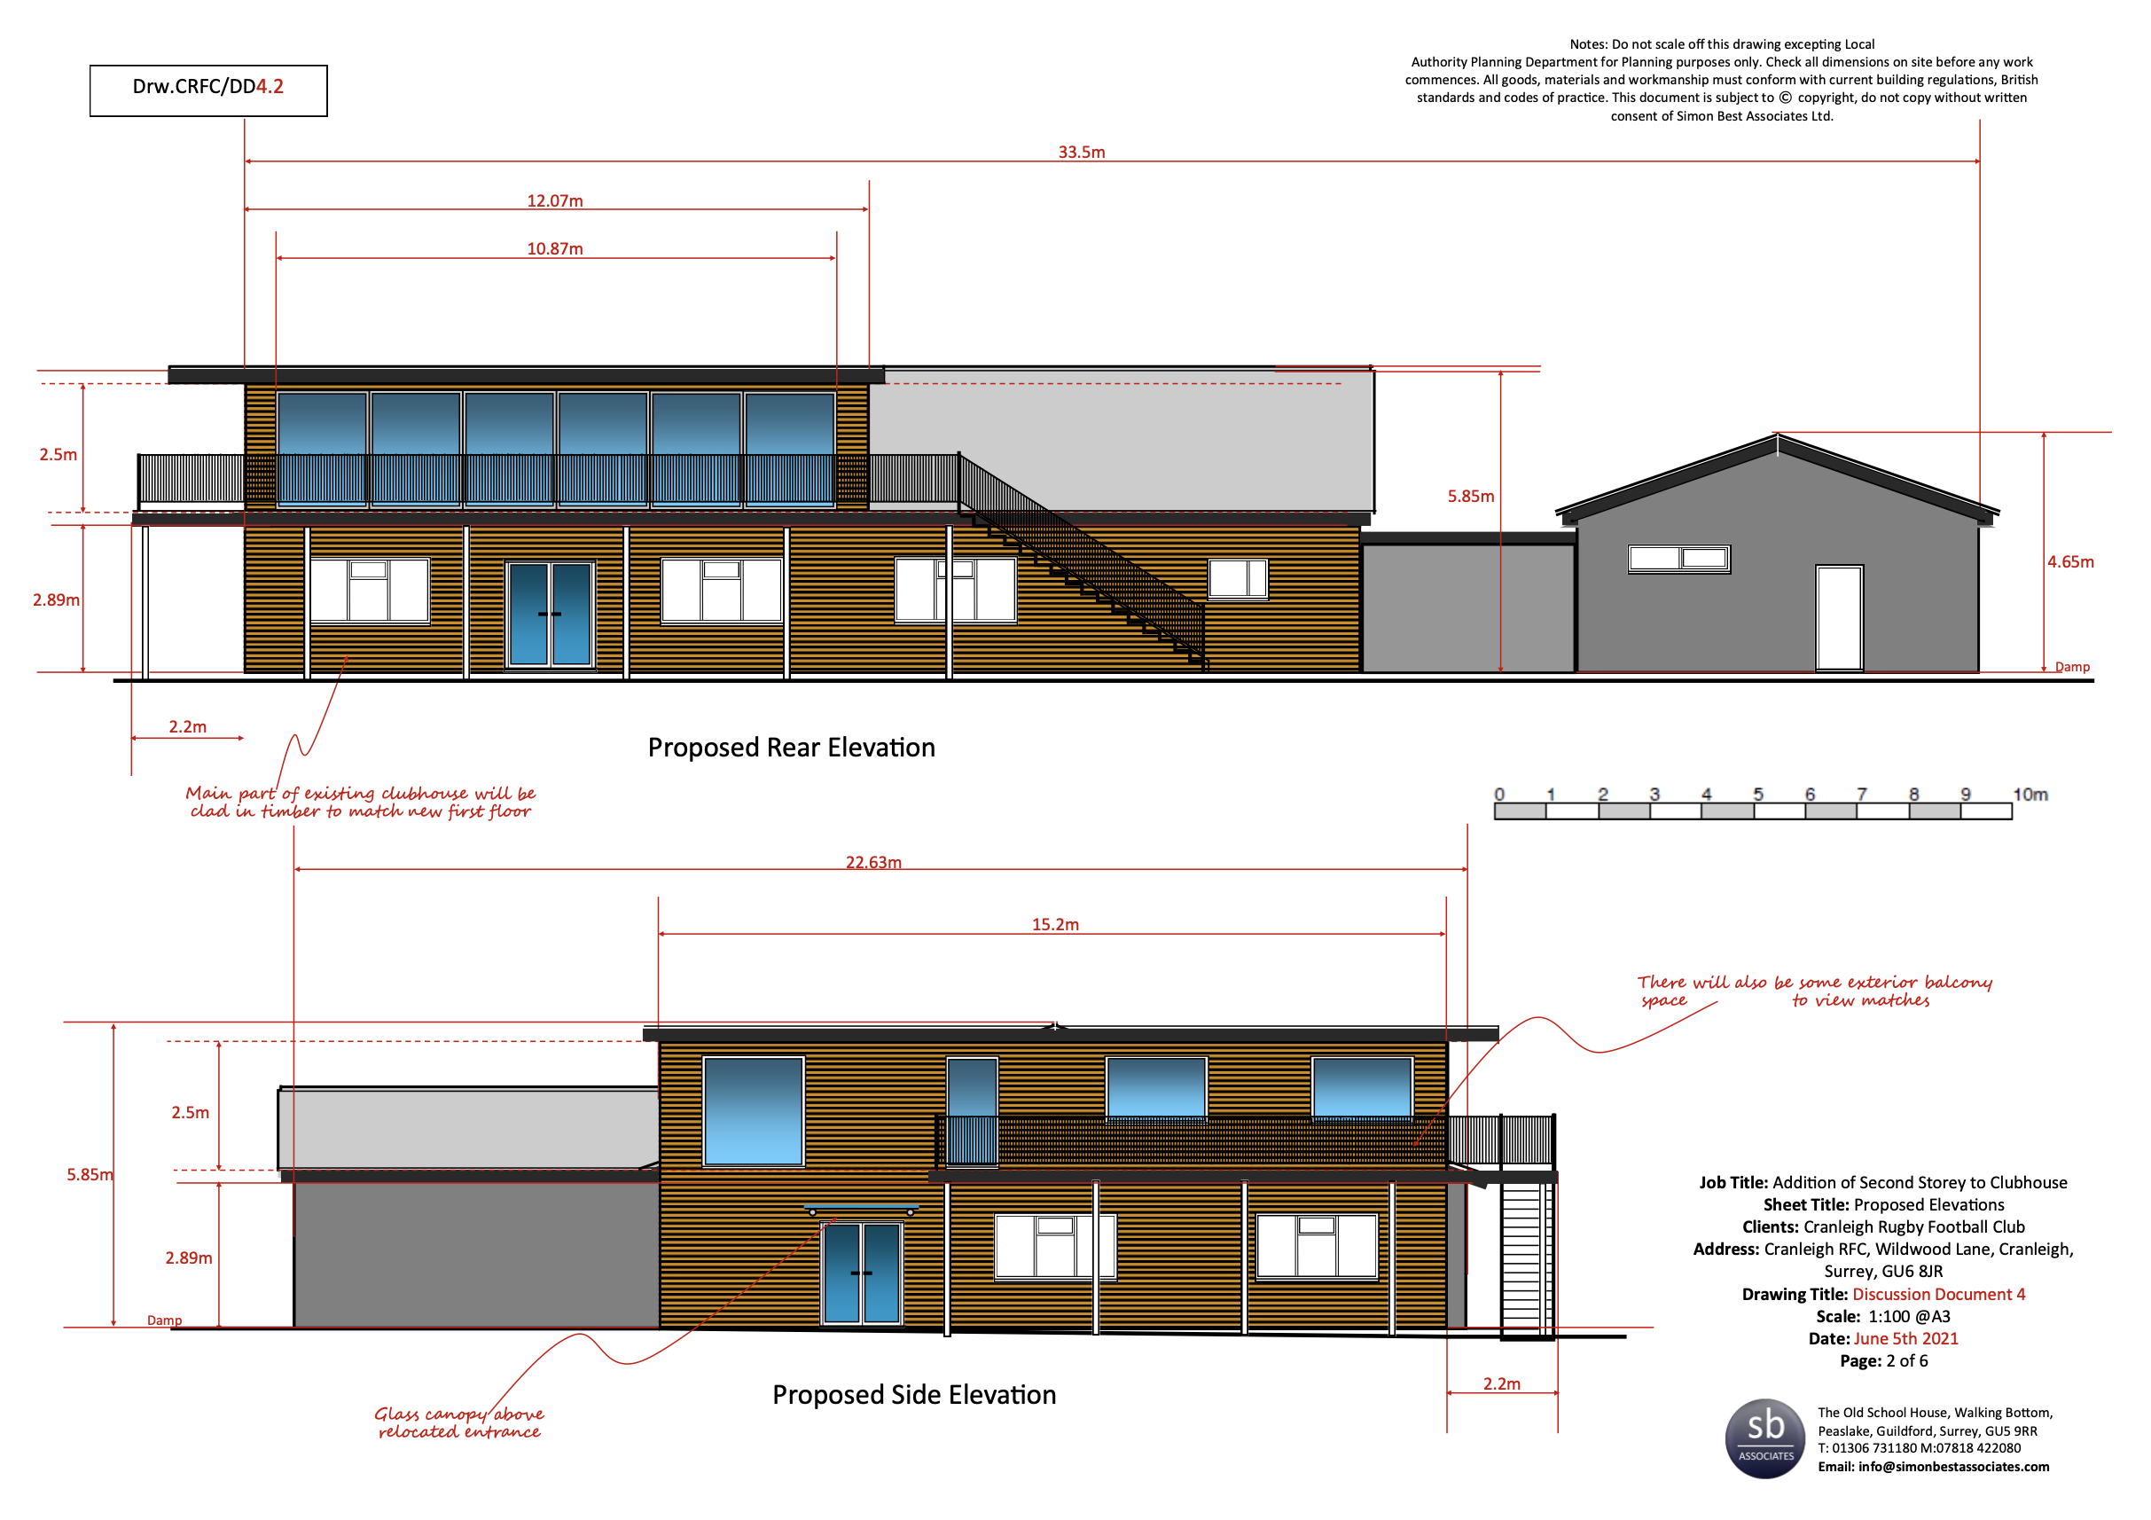
President’s Address -Gareth Stingemore

Slide 10
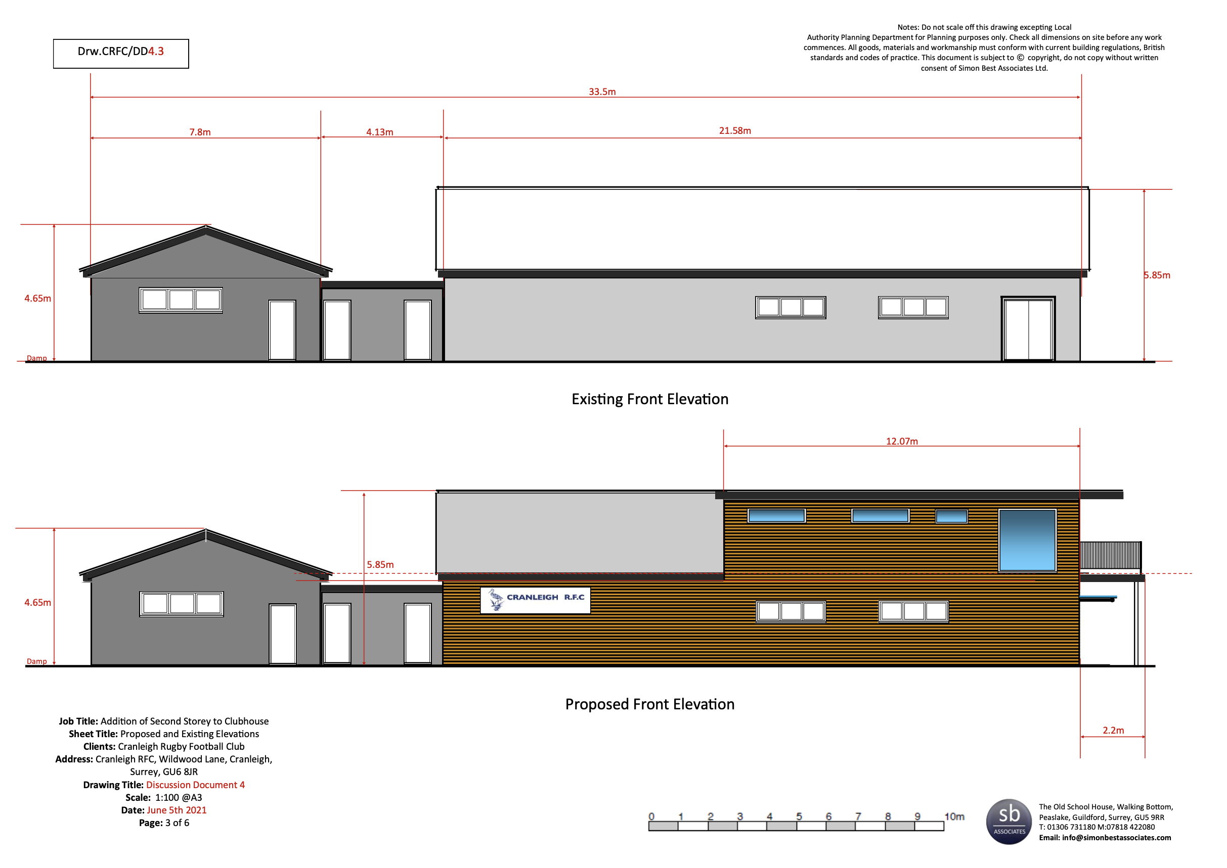
President’s Address - Gareth Stingemore

Slide 11
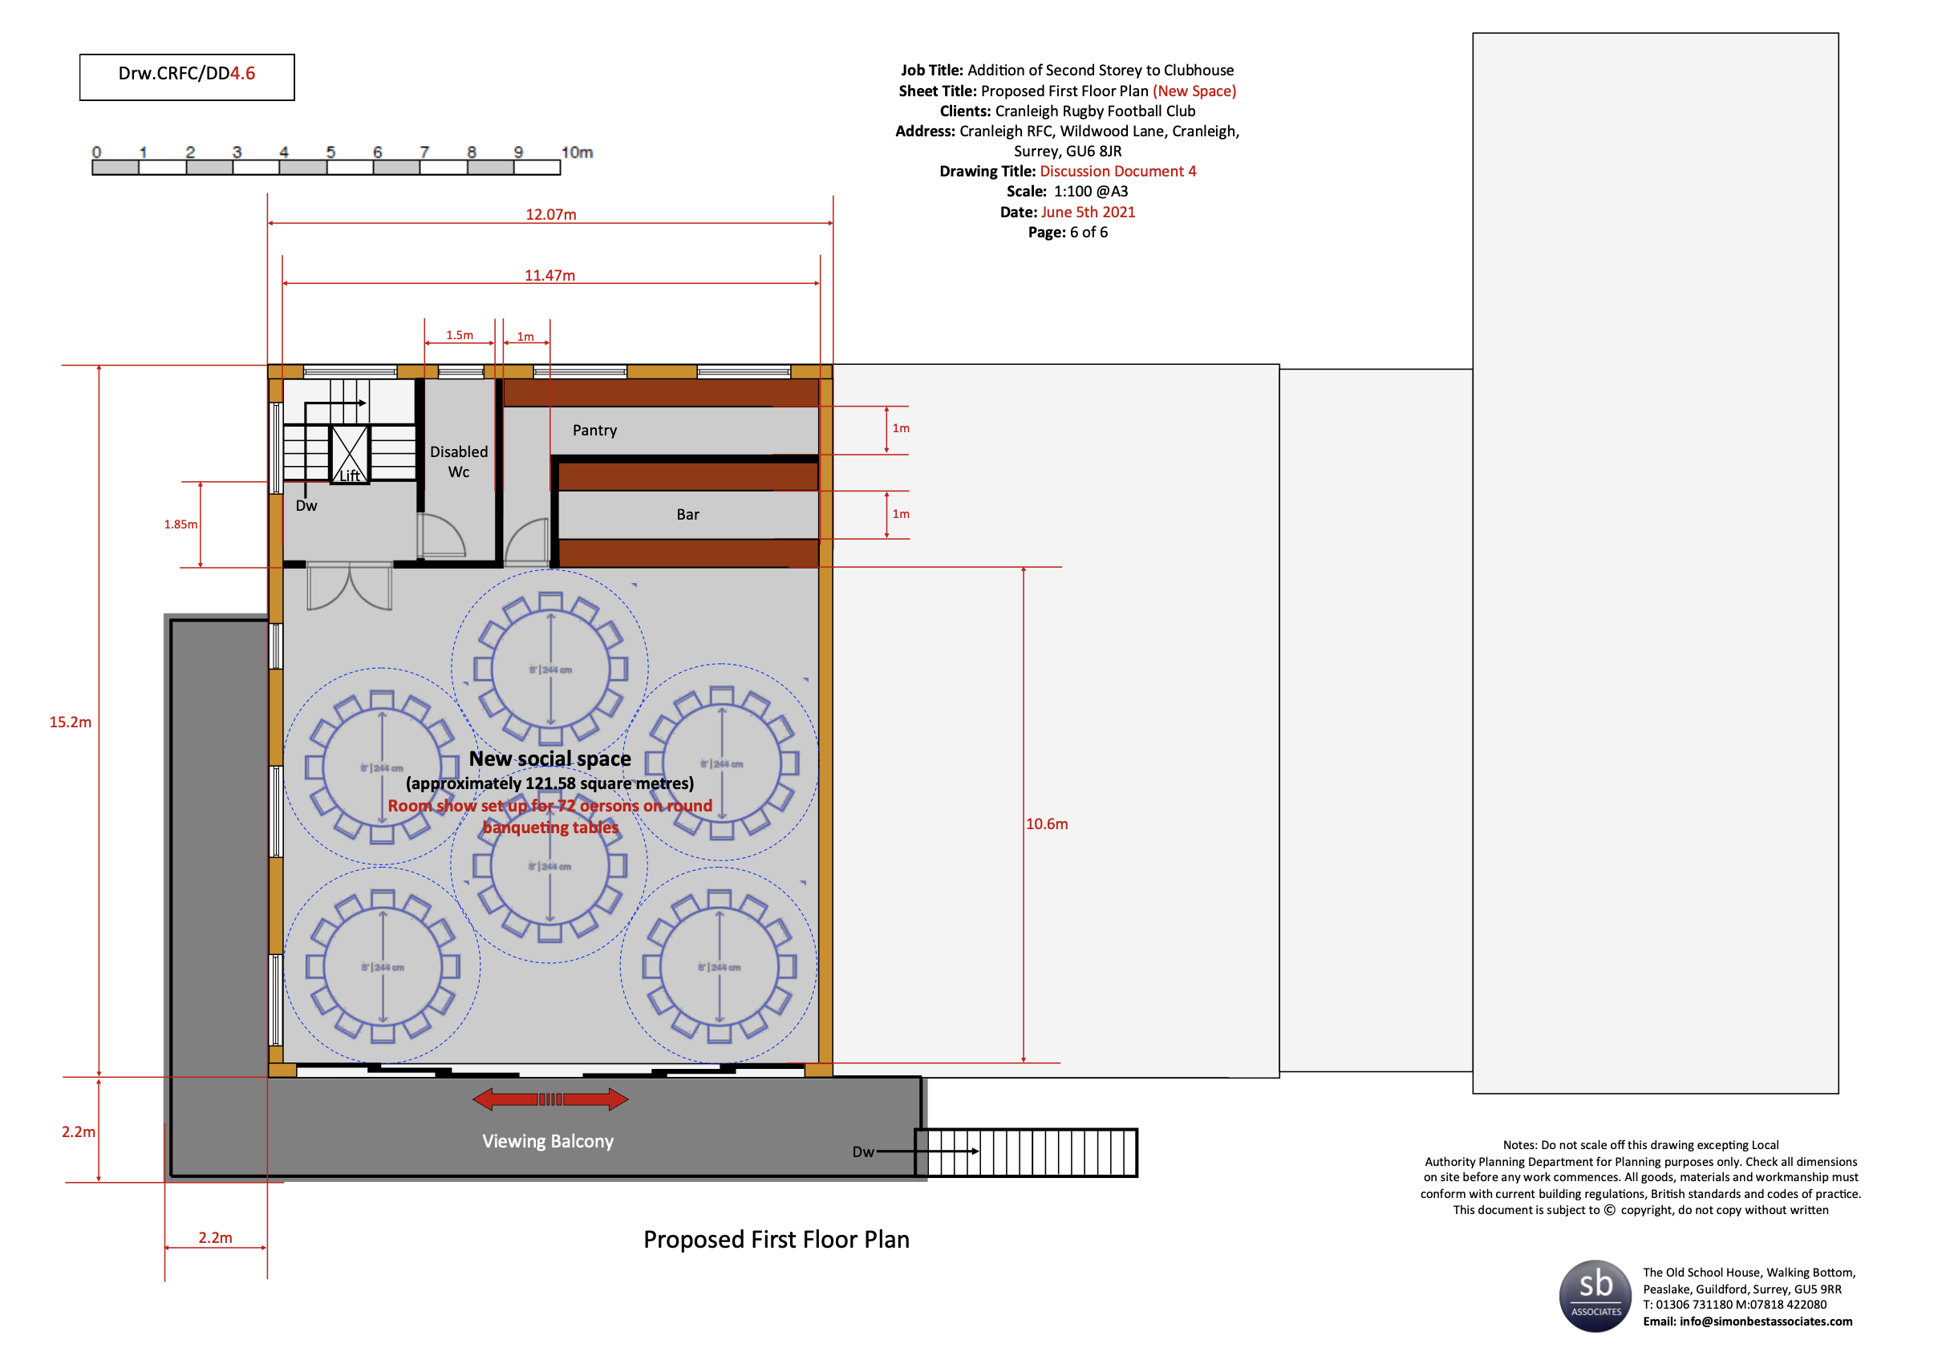
President’s Address - Gareth Stingemore

Slide 12
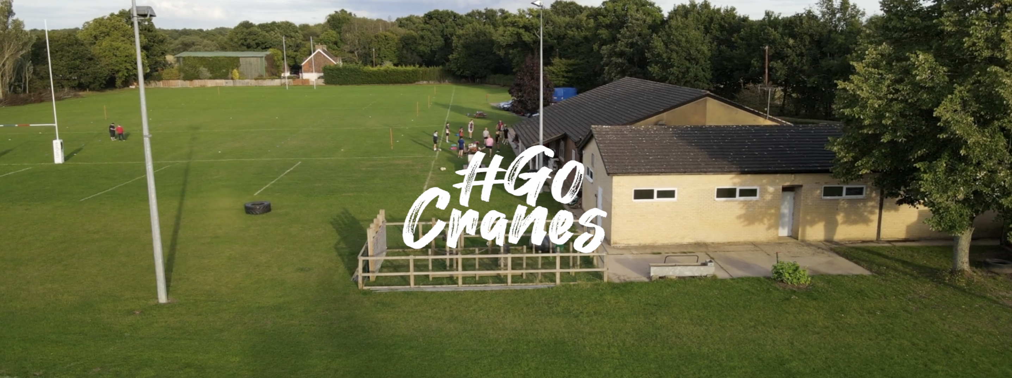
President’s Address - Gareth Stingemore

Slide 13
Meeting From Last AGM
Proposer:
Seconder:
Those in favor:
Those against:
www.cranleighrugbyclub.co.uk/annual-general-meeting

Slide 14
Nominations for 21/22 Club Committee
President: Gareth Stingemore Chairman: Toby Eves Vice-Chairman: Paul Mahon Mini and Youth Chairman: Paul Denyer Treasurer: Mike Chapman Hon.Secretary: Amanda Newman Parsons
Membership Secretary: Vacant
Bar Secretary: Paul Mahon
VP's Secretary: Rob Wheeler Communications Secretary: Nick Hendy Grounds Secretary: Simon Killick 2nd XV Captain: Vacant Vets XV Captain: Gareth Stingemore Vet Team Manager: Rob Wheeler Fixtures Secretary: Vacant Events and Social Secretary: Vacant Fundraising and Sponsorship Secretary: Gareth Stingemore Safeguarding Officer: James Moore

Slide 15
Election of Officers
Proposer:
Seconder:
Those in favor:
Those against:
www.cranleighrugbyclub.co.uk/annual-general-meeting

Slide 16
Finance for 20/21 Year end 31/03/21 – Mike Chapman
Profit and Loss Headlines
Operating Bar Turnover 2021 2020
Operating Income bar £ 7,469 £45,362
Cost of Sales -£11,069 -£37,797
Gross Profit on Bar -£ 3,620 £ 7,565
Admin Expenses -£55,301 -£79,307
Operating Loss -£58,921 -£71,742
Other Income (subs, Grants) £76,352 £66,952
Profit and Loss for Financial Year £17,431 -£4,790
Cash Position
30/05/20 : £17,432
30/05/21 : £73,989
07/06/21 : £110,000 including £20k in reserve and M+J funds

Slide 17
Balance Sheet 30/05/21 – Mike Chapman
2021 2020
Fixed Assets £46,727 £57,654
Current Assets
Stocks 525 3,791
Debtors 3,090 5,296
Cash 73,989 17,432
81,618 26,519
Creditors 25,007 2,280
Net Current Assets 52,597 24,239
Net Assets 99,324 81,893

Slide 18
Our Fiscal Approach in an Uncertain Year
We have remained cautious throughout this period whilst:
fundraising
applying for all available grants both local and national
keeping cash reserves high as we just did not know the future and risk management was key
Subs down to 20k from 26k prior year but still vital
Finished in a very strong cash position with a further RFU grant gained since March 30th for operating costs.
In addition, we have 7k coming from the Waites association
Plus we have merged the accounting of the M+J into the Senior Club giving the strong cash balance of £110K currently, typically 20-30k
We have applied for a further 50k loan from the RFU over 8 years to fund full drainage of the 1st pitch for next off season.
We can now look to significantly enhance the facilities around the club with things such as:
Covered stands
Coffee bars for SC ground
Gym improvements
Parking
New Containers
Electronic scoreboards
Further drainage improvements to other pitches
And anything else the members want to be considered

Slide 19
Club Status
Current Club Status
Community Amateur Sports Club or CASC, it’s not incorporated
Does allow
80% rates relief
Exemption from corporation tax for trading under 50k
Apply for Gift Aid on donations
Minimal reporting
Does not allow
The club is not a recognized entity in its own right
Can not hold loans or Property in its own right, ground is held in a trust currently
Can not employ staff
The committee remains personally liable for debt and in certain circumstances/issues and events at the club
Can not apply for RFU loans and the RFU is pushing for all clubs to be incorporated
Proposed that we change the status of the club to allow us to progress the structures and commercial maturity of the organisation by becoming an incorporated entity of some sort

Slide 20
Club Status Options for Change

Slide 21
Proposed Status for the Club for Immediate Effect
We propose that we move the club to be a Cooperative Society with a CASC status
Plus establish an Operating Ltd Company as a subsidiary when necessary
The benefits being
Allows the limited liability required
Allows the club to own assets, land etc
Allows the club to take on loans and employment contracts
All members who pay subs are then owners of the club for as along as they do but can never gain from the operation or asset sales from the club
We can keep our CASC benefits
Regulated by the FCA and the RFU are a Cooperative Society
Supported by an RFU documented process
We will use an RFU recommended professional to oversee the process of setting up the entity and moving the assets to the new Society
Will take 6-9 months to effect
More information can be found here: https://www.englandrugby.com/participation/running-your-club/legal-and-administration/incorporation

Slide 22
Vote Now
Proposer:
Seconder:
Those in favor:
Those against:

Slide 23
Break

Slide 24
Mini and Youth Chairman – Paul Denyer
Membership
Finances
Playing
Recognition

Slide 25
Communication’s Report – Nick Hendy
Re-branded our website and social media content with Silverback Studios.
Distributed over 7,500 recruitment leaflets to generate new players.
Weekly newsletters on email, we communicate to over 1,100 signed up members.
Facebook 800+ members, Instagram Followers 698 and Twitter 376 Followers.
Thanks to Dan Spong for support of Mini and Youth comms and Silverback for support on website rebrand.

Slide 26
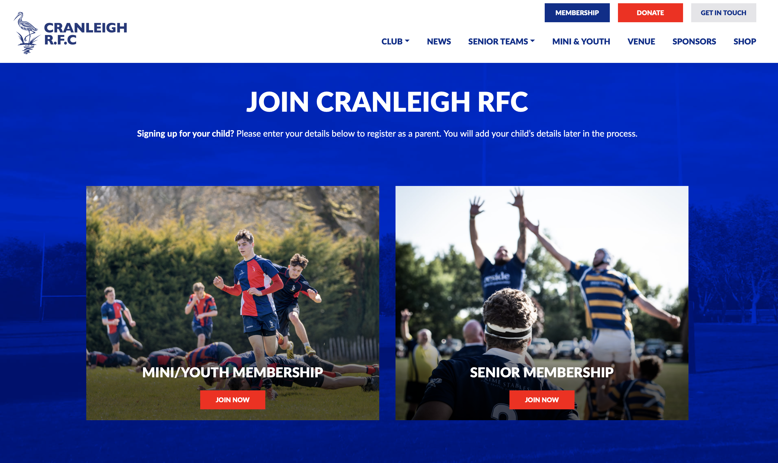
Communication’s Report – Nick Hendy
Online Membership (August 2021)
Online Shop (August 2021)

Slide 27
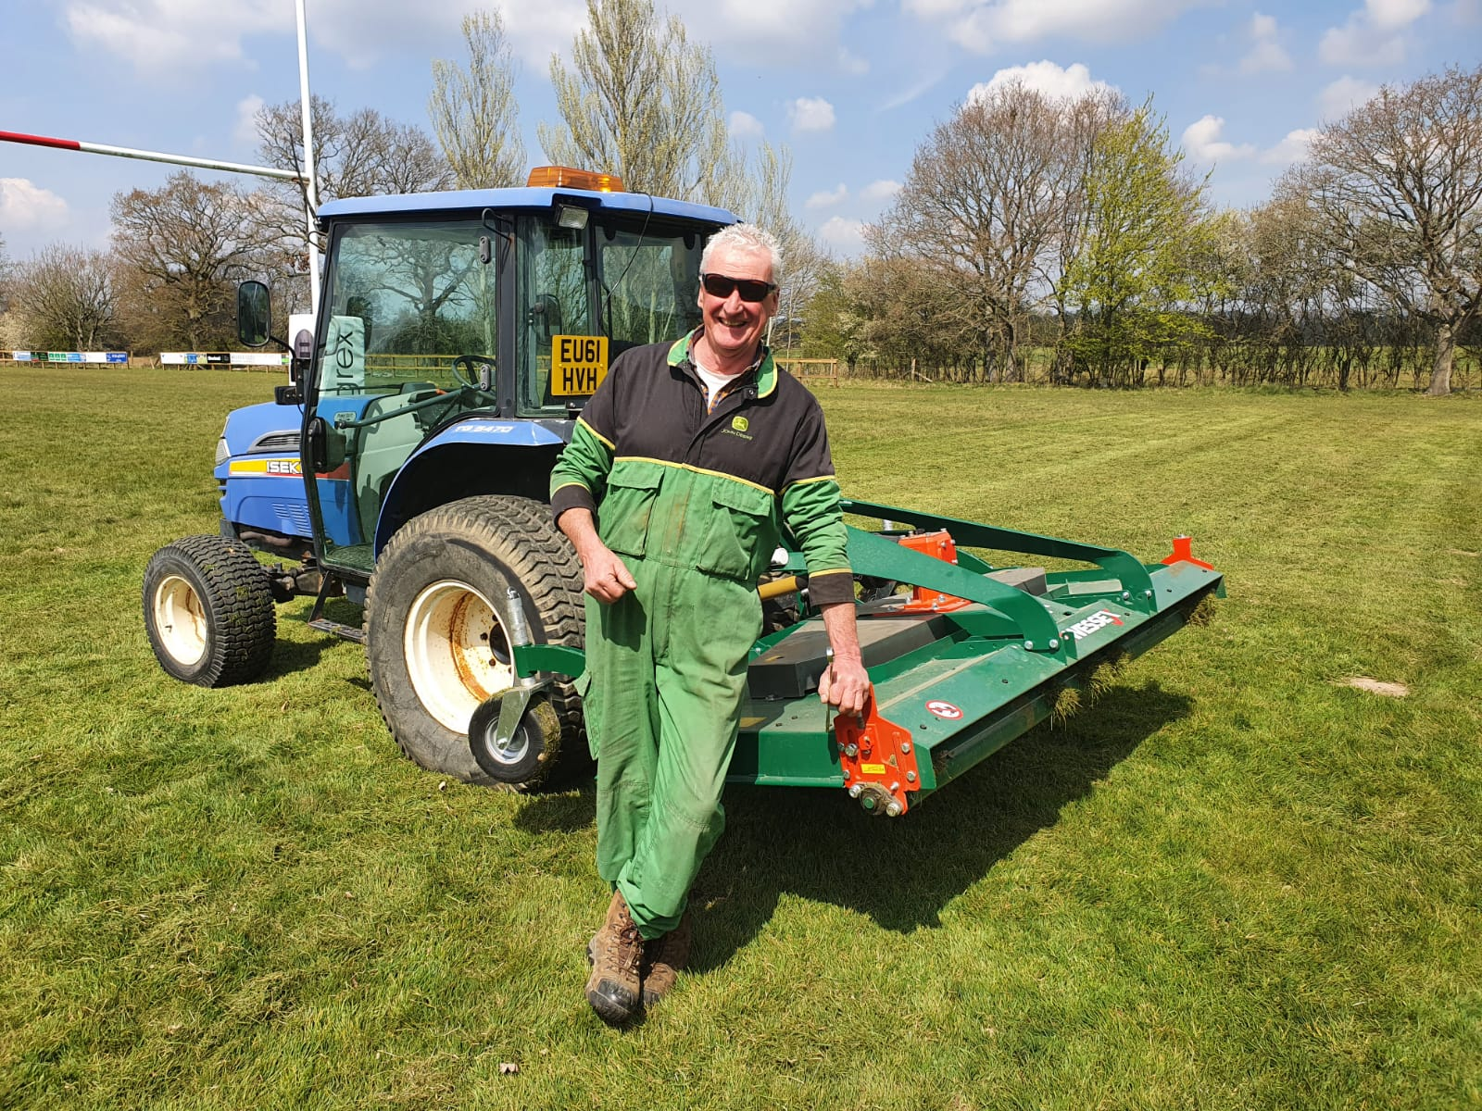
Grounds Report – Simon Killick
Drainage
Tractor and Roller
Future Plans

Slide 28
Season Review 2020/21 – Nic Churchill
Disjointed and difficult season, extraordinarily well handled by our senior squad and wider Cranes community.
Lockdown challenges and adapted training sessions helped look after both our players physical and mental health throughout.
Training session participation numbers reached 50 plus pre-Christmas and averaged above 30 after the last lockdown ended.
Overall active adult player numbers are also up on the previous season, with almost 80 players having taken part in training sessions and matches throughout the season.
Successful final run of matches to close out the season; beating Effingham & Leatherhead and Met Police, losing to Chobham and Weybridge Vandals, however performing fantastically well against sides up to 3 levels above us.

Slide 29
21/22 Season Preview – Nic Churchill
No confirmed dates yet from the RFU regards progressing from stage D2 to E then F.
The 2021/22 season is expected to see a return to rugby in its full form and be restriction free by the start of September.
The Summer Touch activities will continue through until the middle of July with Preseason commencing on the 21st.
Increased active player count and weekly participation numbers point to strong 1st and 2nd XV squads as well as a vibrant vets.
Our now thriving Colts program will see players begin to incorporate into senior rugby from the 1st of January 2022 and will boost the squad immensely.
Expectations - Both senior teams are more than capable of challenging for their respective leagues and a combined squad should enjoy a decent run in the Surrey Cup.

Slide 30
Senior Coaching and Support Team
– Nic Churchill
Philosophy – “To develop players of all abilities whilst providing fun, engaging practice in a safe and friendly environment”
DOR/Head Coach – Nic Churchill
Attack Coach – Jonny Burden
Forwards Coach – Ryan Thornber
Skills Coach – Mike White
Strength & Conditioning – Sam Lawrence
Lead Physio – Alice Sugden
Co Physio – TBC
Statistics & Analysis – Geoff Noonan
1st XV Team Manager - TBC
2nd XV Team Manager - TBC

Slide 31
Dates for Diary– Nic Churchill
21st July – Start of Preseason Training
29th August – Cranleigh Vs The CALM Barbarians
4th September – Preseason Friendly 1
11th September – Preseason Friendly 2
18th September
1st XV vs Old Blues (H)
2nd XV vs Weybridge Vandals (A)
25th September
1st XV vs Old Wimbledonians (A)
2nd XV vs Guildfordians (H)
2nd October
1st XV vs Chipstead (H)
2nd XV vs Old Emanuel (A)
Date TBC – Surrey Shield Round 1 - Cranleigh Vs Chipstead

Slide 32
Ladies Rugby Coming Soon – Nic Churchill
Exciting new era in our Cranes history – Ladies rugby at Cranleigh by the start of the 22/23 season.
Structural and organisational changes to the clubhouse coming next season to support a ladies rugby team.
Inner Warrior Ladies Rugby camps already planned for Spring 2022 to boost awareness and participation.
Strong coaching and support team in the pipeline to create an inclusive, fun and friendly environment for all players.

Slide 33
Any Questions

Slide 34
A.O.B

Slide 35
AGM Close

